Slide 1
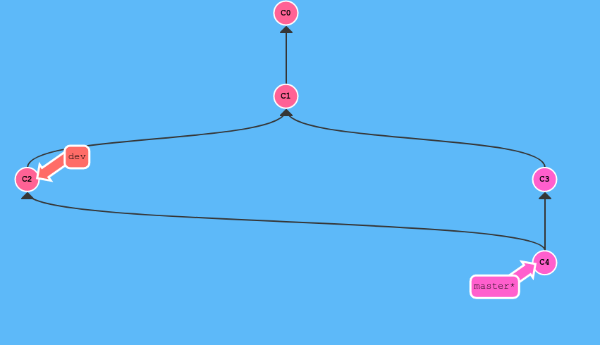
What is Git and Version Control?
Keep track of code changes and revert
to old changes
Keep and merge multiple
versions of a project
Synchronize projects between machines
Keep your project “in the cloud”

